Slide 1

Department of Cyber Security
2026-2027- Odd Semester
III Year /V Sem
CS23533-FOUNDATIONS OF ARTIFICIAL INTELLIGENCE
Review 1– 09.09.2026

Slide 2
Introduction
2
Healthcare referral decisions must be timely and appropriate to ensure patients reach hospitals with the required specialties, facilities, and resources. However, hospital selection often depends on outdated information, personal familiarity, or manual coordination, which can cause delays.
The AI-Based Smart Patient Referral and Hospital Selection System uses rule-based AI to analyze patient symptoms, identify a possible specialty and urgency level, and rank hospitals based on medical requirements and current availability.
The system provides transparent recommendations, explanations, and referral tracking through interfaces for patients, caretakers, hospitals, and administrators.
Human Involvement: The system provides decision support, not a diagnosis. Caretakers confirm referrals, and healthcare professionals remain responsible for clinical decisions.
Project Scope: A web-based prototype tested with synthetic data, designed to support hospital selection and referral coordination.
Department of Cyber Security | Project Review – 1 | 2026-2027

Slide 3
Problem Statement
3
Problem: Lack of a centralized, real-time system to match patients with suitable hospitals based on their medical needs, specialties, facilities, and resource availability.
Importance: Delays, incorrect referrals, and unavailable resources can affect treatment outcomes, especially during medical emergencies.
Affected Stakeholders: Patients are the primary stakeholders, as delays in hospital referrals and unavailability of required medical facilities can affect timely treatment and patient outcomes.
Motivation: To develop a reliable, transparent, and explainable decision-support system that identifies the required medical specialty and urgency, evaluates hospital capabilities, and recommends the most suitable hospital using current information.
Department of Cyber Security | Project Review – 1 | 2026-2027

Slide 4
Motivation
4
Healthcare referral inefficiency is a high-stakes, real-world problem well-suited to classical AI techniques such as knowledge representation, search, and constraint satisfaction.
Growing interest in AI-based clinical decision-support and expert systems for patient triage in hospital networks.
Faster referrals, reduced treatment delay, optimal use of hospital resources, and explainable recommendations for clinicians.
Directly applicable to hospital networks and emergency services; demonstrates AI reasoning techniques beyond machine learning.
Department of Cyber Security | Project Review – 1 | 2026-2027

Slide 5
Objectives
5
Patient Analysis: Collect patient details and identify specialty, urgency, and emergency warnings using rule-based reasoning.
Hospital Recommendation: Rank available hospitals using a transparent score of 0–100 based on medical needs, resources, and distance.
Explainable Results: Display the reasons for each recommendation and the hospital score breakdown.
Referral Tracking: Record referral status from confirmation to hospital acceptance or rejection.
Live Updates: Update hospital resources, specialists, and emergency availability.
Administration & Navigation: Manage hospital records, maintain activity logs, and display hospital routes on a map.
Department of Cyber Security | Project Review – 1 | 2026-2027

Slide 6
Literature Survey
6
S.No. | Author & Year | Method / Technique | Key Findings | Limitations
1 | Chi, Street & Ward, 2008 | Expert System & Decision Support optimization | Prediction-based referral algorithm improved hospital assignment accuracy | Relies on static rules; limited adaptability to real-time data
2 | Abdel-Hafez et al., 2023 | AI-based Referral Triage (clinical prioritization) | Improved triage prioritization using AI-based classification | Requires large labeled clinical datasets for training
3 | Määttä et al., 2023 | Clinical Decision Support System | High diagnostic performance and triage safety shown in usability trials | Usability varies across clinical settings; limited explainability
Department of Cyber Security | Project Review – 1 | 2026-2027

Slide 7
Existing System
7
Manual patient referral based on physician experience and judgement.
Little to no software support — at most, static hospital directories or phone-based coordination.
Advantages: simple, requires no technology, relies on clinical intuition
Limitations: slow, inconsistent, ignores facility/resource availability, prone to human error, no transparency
PATIENT / EMERGENCY CASE
↓
PHYSICIAN ASSESSMENT
↓
MANUAL HOSPITAL SEARCH
↓
AVAILABILITY CHECK
↓
REFERRAL & TRANSPORT
Department of Cyber Security | Project Review – 1 | 2026-2027

Slide 8
Proposed System
8
The proposed system consists of five main modules: Patient Data Collection, Patient Requirement Analysis, Hospital Evaluation, Hospital Ranking, and Referral Recommendation & Explanation. A separate Hospital Administrator component maintains hospital information, facilities, resources, and availability.
Knowledge-Based Agent with Forward Chaining, Best-First Search, and Constraint Satisfaction.
Automatically factors in specialist availability, medical facilities, resource load, and travel distance simultaneously.
1. PATIENT / USER INPUT
Patient details & symptoms
↓
2. REQUIREMENT ANALYSIS
Identify specialty & healthcare needs
↓
3. HOSPITAL DATABASE
Facilities, resources & availability
↓
4. AI-BASED HOSPITAL SELECTION
Best-First Search + CSP
↓
5. REFERRAL RECOMMENDATION
Ranked hospital & referral decision
Department of Cyber Security | Project Review – 1 | 2026-2027

Slide 9
System Architecture / Block Diagram
9
PATIENT/USER INPUT
PATIENT REQUIREMENT
ANALYSIS
KNOWLEDGE-BASED REASONING + BEST-FIRST SEARCH
CONSTRAINT SATISFACTION
HOSPITAL RANKING & REFERRAL
Patient details flow through symptom analysis and AI-based specialist identification into hospital matching, producing a ranked, explainable hospital recommendation.
Department of Cyber Security | Project Review – 1 | 2026-2027

Slide 10
Methodology
10
1. Patient details, symptoms, pain severity and emergency level entered via Module 1
2. Inputs are validated and symptoms are encoded for rule matching
3. Apply knowledge-base rules to map symptoms to the likely condition and specialist
4. Knowledge-Based Agent (Forward Chaining) + Best-First Search for hospital ranking
5. Constraint Satisfaction to verify specialist, facility, and resource match per hospital
6. The system generates a ranked hospital recommendation and provides referral confirmation
Department of Cyber Security | Project Review – 1 | 2026-2027

Slide 11
Technologies Used
11
Languages: HTML, CSS, JavaScript
Backend: Node.js 22, Express.js 4
Database: SQLite (better-sqlite3)
Libraries: bcryptjs, express-session, dotenv, cors
Maps: Leaflet, OpenStreetMap, OSRM
Development Tool: Visual Studio Code
Browser: Chrome, Edge or Firefox
Hardware: Dual-core CPU, 4 GB RAM, 500 MB storage
Department of Cyber Security | Project Review – 1 | 2026-2027

Slide 12
Module Description
12
Module 1 – Patient Data Collection
Module 2 – Patient Requirement Analysis
Module 3 – Hospital Evaluation & Ranking
Module 4 – Referral Recommendation & Explanation
Module 5 – Hospital Administration & Database Management
Department of Cyber Security | Project Review – 1 | 2026-2027

Slide 13
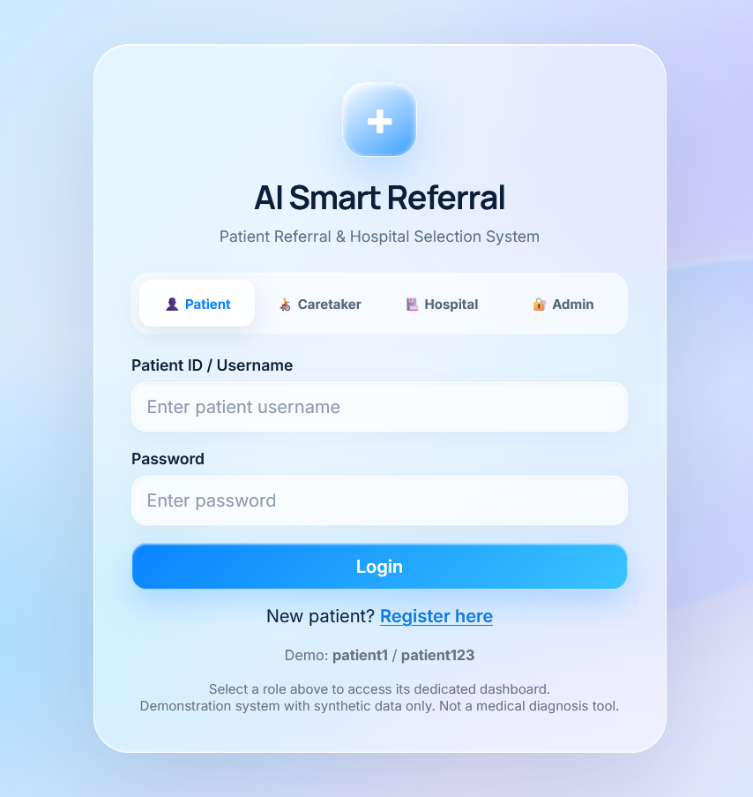
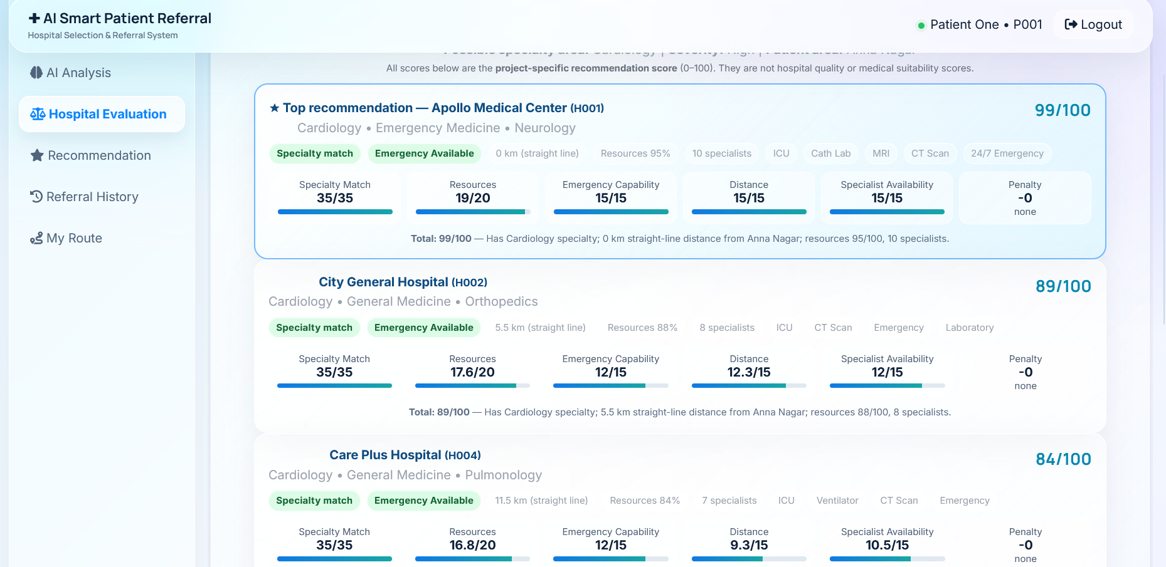
Preliminary Results
13
Department of Cyber Security | Project Review – 1 | 2026-2027

Slide 14
Project Schedule
14
Activity | Month 1 | Month 2 | Month 3 | Month 4
Literature Survey | ✓ | ✓ | - | -
Problem Identification | ✓ | - | - | -
System Design | - | ✓ | ✓ | -
Implementation | - | - | ✓ | ✓
Testing & Evaluation | - | - | - | ✓
Department of Cyber Security | Project Review – 1 | 2026-2027

Slide 15
Current Progress
15
✓ Literature survey completed (referral & intelligent AI techniques)
✓ Problem identification completed (gaps in manual referral)
✓ Methodology finalized (Knowledge-Based Agent + Best-First Search + CSP)
✓ Module 1 – Patient Data Collection completed
✓ Module 2 – Patient Requirement Analysis completed
✓ Module 3 – Hospital Evaluation & Ranking in progress
☐ Testing and final evaluation pending
Department of Cyber Security | Project Review – 1 | 2026-2027

Slide 16
Future Work
16
☐ Complete Module 3 – Hospital Evaluation & Ranking
☐ Implement Module 4 – Referral Recommendation & Explanation
☐ Implement Module 5 – Hospital Database & Administrator
☐ Integrate and test AI techniques with the complete referral workflow
☐ Conduct experiments using sample patient case scenarios
☐ Evaluate recommendation accuracy/relevance and response time
☐ Prepare final documentation and live demonstration
Department of Cyber Security | Project Review – 1 | 2026-2027

Slide 17
Conclusion
17
The AI-Based Smart Patient Referral and Hospital Selection System automates patient triage and hospital matching using classical AI reasoning techniques.
Combines a Knowledge-Based Agent, Best-First Search, and Constraint Satisfaction to deliver explainable, resource-aware hospital recommendations in one integrated system.
Explainable scoring considers specialty, resources, emergency capability, distance and availability.
Human oversight remains essential for clinical decisions.
Expected Outcome: A transparent, integrated hospital referral support system.
Department of Cyber Security | Project Review – 1 | 2026-2027

Slide 18
References
18
[1] Chi, C.-L., Street, W. N., & Ward, M. M. (2008). Building a hospital referral expert system with a prediction and optimization-based decision support system algorithm. Journal of Biomedical Informatics, 41(2), 371–386. https://doi.org/10.1016/j.jbi.2007.10.002
[2] Abdel-Hafez, A., Jones, M., Ebrahimabadi, M., Ryan, C., Graham, S., Slee, N., & Whitfield, B. (2023). Artificial intelligence in medical referrals triage based on clinical prioritization criteria. Frontiers in Digital Health, 5, Article 1192975. https://doi.org/10.3389/fdgth.2023.1192975
[3] Määttä, J., Lindell, R., Hayward, N., Martikainen, S., Honkanen, K., Inkala, M., Hirvonen, P., & Martikainen, T. J. (2023). Diagnostic performance, triage safety, and usability of a clinical decision support system within a university hospital emergency department: Algorithm performance and usability study. JMIR Medical Informatics, 11, e46760. https://doi.org/10.2196/46760
[4] Omotosho, A., Adegbola, O., & Adebo, A. (2016). A patient-based hospital referral decision support system. International Journal of Computer Applications, 155(10), 38–43. https://doi.org/10.5120/ijca2016912459
[5] Semigran, H. L., Linder, J. A., Gidengil, C., & Mehrotra, A. (2015). Evaluation of symptom checkers for self diagnosis and triage: Audit study. BMJ, 351, h3480. https://doi.org/10.1136/bmj.h3480
Department of Cyber Security | Project Review – 1 | 2026-2027

Slide 19
THANK YOU
Questions & Suggestions

